Slide 1
What is graph?

Slide 2
What is graph?
Graph is a structure amounting to a set of objects in which some pairs of the objects are in some sense “related”.
The objects called vertices (also called nodes or points).
Each of the related pairs of vertices is called an edge.

Slide 3
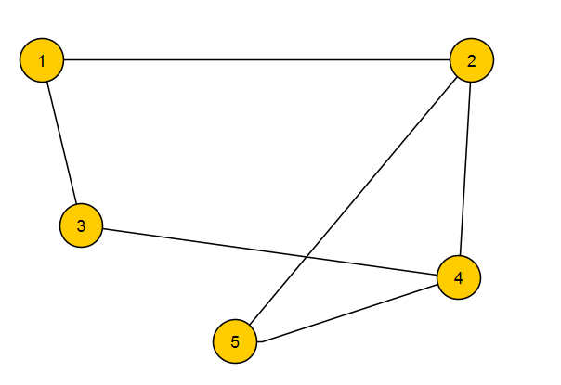
What is graph?
Example:
Vertices (yellow circles) is V = {1,2,3,4,5}
Edges (black lines) is pairs of vertices that are connected. In this case edges are: E = {(1, 2), (1, 3), (2, 4), (2, 5), (3, 4), (4, 5)}
We are also defining graph as pair of V and E. If briefly, then G = (V, E). We will use this notation.

Slide 4
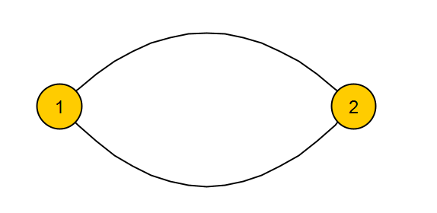
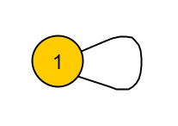
What is graph?
Parallel vertices:
Two or more edges joining a same pair of vertices.
In example vertex 1 and 2 connected with 2 edges.
Self-loops
Edge that starts and ends in the same vertex.

Slide 5
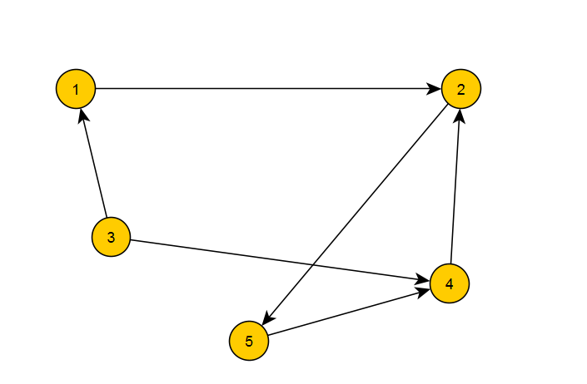
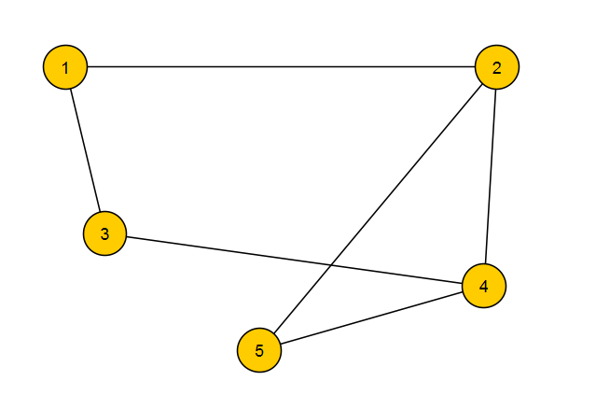
What is graph? Graph types
If the edges in a graph are directed, i.e., pointing in only one direction, the graph is called a directed graph or digraph.
If the edges in a graph have no direction, the graph is called a undirected graph.

Slide 6
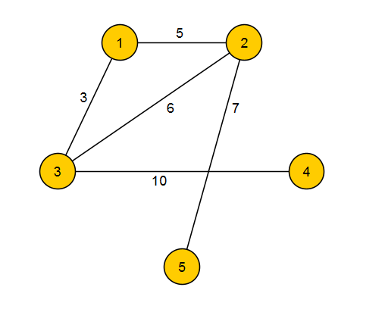
What is graph? Graph types
A graph where each edge have a numerical “weight” called weighted graph.

Slide 7
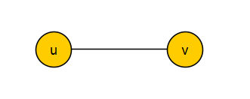
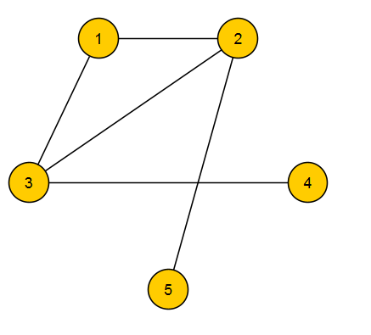

What is graph? Terminology
Vertices u and v called adjacent if u and v connected with some edge.
The number of edges that are incident to the vertex called degree of vertex or deg(v). A vertex is incident to an edge if that vertex is one of the two vertices the edge connects. In example, deg(3) = 3.
Leaf vertex is a vertex with deg(v) = 1, in example, 5 is a leaf vertex.
Isolated vertex is a vertex with deg(v) = 0 , in example, 6 is a isolated vertex.

Slide 8
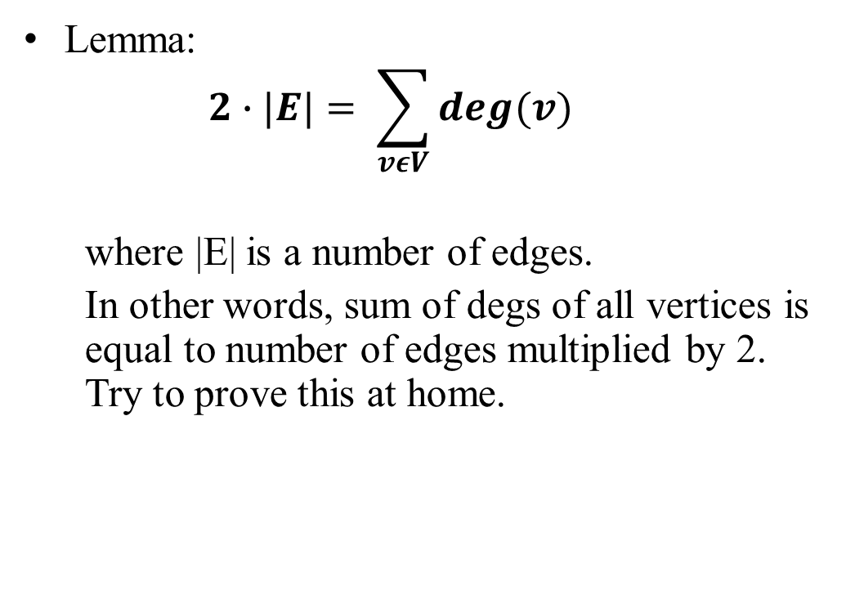
What is graph? The handshaking lemma
Lemma:
$$2∙|E|= \sum_{vεV}{deg(v)}$$
where |E| is a number of edges.
In other words, sum of degs of all vertices is equal to number of edges multiplied by 2. Try to prove this at home.

Slide 9
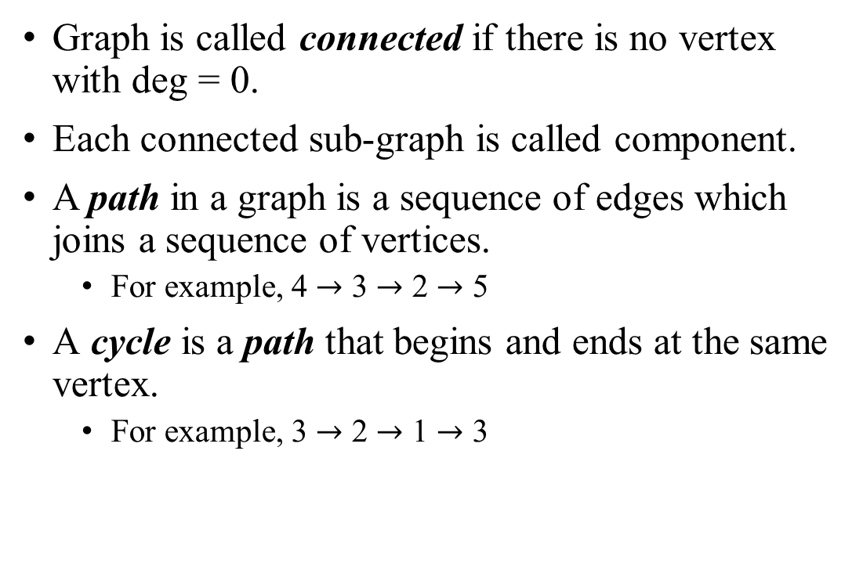
What is graph? Terminology
Graph is called connected if there is no vertex with deg = 0.
Each connected sub-graph is called component.
A path in a graph is a sequence of edges which joins a sequence of vertices.
For example, 4 $→$ 3 $→$ 2 $→$ 5
A cycle is a path that begins and ends at the same vertex.
For example, 3 $→$ 2 $→$ 1 $→$ 3

